Slide 1
Your information: is
your data ready for AI?
Is my company’s data ready for AI, and what must I fix first?
Applied AI and Automation | Session 4 of 12
KLAi Professional Learning | Jotham Martin Wambi
Notes:
Welcome back. Last session you wrote a brief for your own task. A brief needs something to work on, so today we look at your company’s information. You apply the readiness scorecard from Session 0 to the sources your task uses, label each by sensitivity, and finish with a scored scorecard and your top three data gaps. Those gaps become your roadmap in Session 12.

Slide 2



Today in one view: what you will leave with
By the end of today you will have
An Information Inventory of the sources your task uses, each labelled by sensitivity
A readiness scorecard for the sources your task uses: six areas rated, with a total out of 12
Your top three data gaps, each with evidence, a first fix and a possible owner
Notes:
Here is what you leave with today. An inventory of the sources your task uses, each one labelled by sensitivity. A scorecard for the sources your task uses, six areas rated and added up to a total out of twelve. And your top three data gaps, each with the evidence, a first fix and a possible owner.
Most of the session is your own work, with a finished example from Nile Valley Foods to copy.

Slide 3
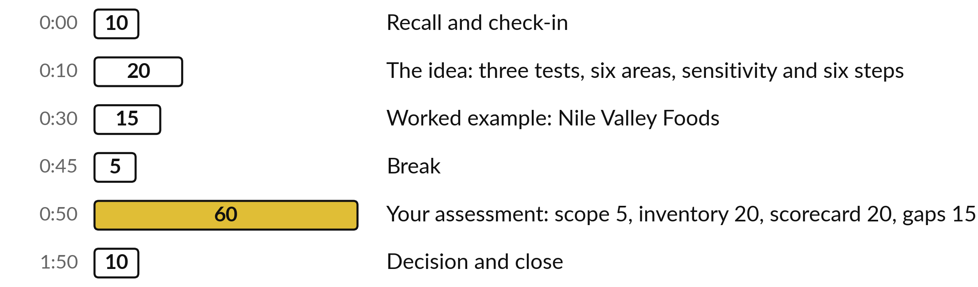
Today: 60 of the 120 minutes
are your own assessment
60 of the 120 minutes are yours: inventory, scorecard and top three gaps.
Notes:
Three parts matter most today. I talk for twenty minutes about the three tests, the six areas, sensitivity and six preparation steps. Then fifteen minutes on a worked example with the real files of Nile Valley Foods. After the break, sixty minutes are yours: five to decide how wide to go, twenty for the inventory, twenty for the scorecard and fifteen for your top three gaps.
If we run late, I shorten my talking and keep your time.

Slide 4

Three questions from last time
1. Name the seven parts of a brief.
2. Name the five questions to ask about an account before company data goes in.
3. Name two things the strong brief gave the tool that the weak prompt lacked.
Answer aloud first. Then we check together.
Notes:
Three quick questions from Session 3. Answer aloud first, and then we check together. It is a warm-up to bring last time back.
Question one. Name the seven parts of a brief. Take a moment.
A good answer is this. Goal, context, inputs, constraints, format with one example of a good answer, how I will check, and what to say when unsure.
Question two. Name the five questions to ask about an account before company data goes in. Say it to yourself first.
A good answer is this. Does it train on my inputs, how long does it keep chats, who in my company sees them, is it a work or a personal account, and does company rule allow it. The answers depend on the plan.
Question three. Name two things the strong brief gave the tool that the weak prompt lacked. Think about your own task as you answer.
A good answer is this. The reader, a limit on what to use, a length and a shape, and what to do when the data cannot explain something. They are on the side-by-side slides.
If an answer was missing, your own task card or last workbook page has it. Now to today.

Slide 5


Words we use today
Word | What it means
Inventory | A list of every source of information your task uses, with its owner, format, place and who may see it.
Metadata | Facts about a file: its date, owner, version and subject. Without them nobody can tell which file is current.
Personal data | Information about a person who can be identified, such as a name with a phone number. Your lawyer checks the Act’s wording. Add “+ Personal” to its level.
Scorecard | Six areas rated Green, Amber or Red: inventory, readable, complete and unique, metadata, rights, current.
Notes:
Four words for today. I give the plain meaning of each, and we use every one of them before the end of the session.
Inventory. A list of every source of information your task uses, with its owner, format, place and who may see it.
Metadata. Facts about a file: its date, owner, version and subject. Without them nobody can tell which file is current.
Personal data. Information about a person who can be identified, such as a name with a phone number. Your lawyer checks the Act’s wording. Add “+ Personal” to its level.
Scorecard. Six areas rated Green, Amber or Red: inventory, readable, complete and unique, metadata, rights, current.

Slide 6
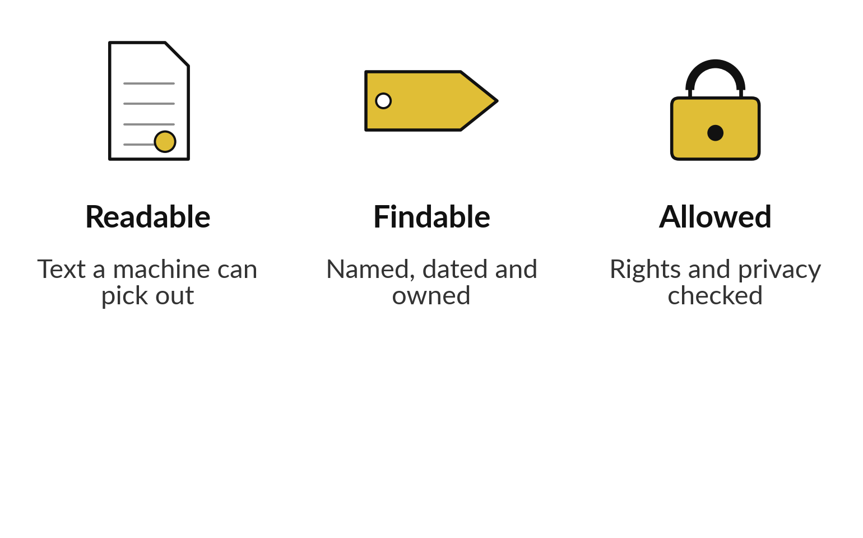
Data is ready for AI when a machine
can read it, find it and use it
Three tests from Session 0, applied to your own company.
A scan is only a picture until text is read from it.
A red on rights stops the project.
Notes:
Session 0 showed a law firm with paper files, scanned PDFs, Word drafts, emails and a half finished index sheet. The lesson was three tests. Can a machine read it?
Can we find it, because it is named, dated and owned?
And are we allowed to use it?
Data passes only if it passes all three. Today you apply those tests to your own company, using the six-area scorecard. Your brief from Session 3 is only as good as the information you put into it.

Slide 7






Score six areas Green, Amber
or Red by a rule you can apply
Area | Green | Amber | Red
Inventory | Written list with owners | List, but gaps or no owners | No list
Readable | Text can be copied | One conversion needed | Paper, photos
Complete and unique | One current copy | Small gaps or copies | Copies disagree
Metadata | Date, owner, version | On some files only | Names like “final2”
Rights | Written down | Known for most sources | Unknown
Current | Updated on a schedule | Mostly up to date | Latest unknown
Green scores 2, Amber 1, Red 0, so the total is out of 12. Unsure between two colours: take the lower.
Notes:
This is the scorecard from Session 0, now with a rule for each colour so two people would rate the same way. Inventory is green when there is a written list with owners. Readable is green when you can select and copy the text. Complete and unique is green when one current copy exists and nothing is missing.
Metadata is green when each file carries a date, an owner and a version. Rights is green when who may use it is written down. Current is green when it is updated on a schedule. Amber means the rule is half met, and a named fix would make it green. Green is two points, amber one, red zero.

Slide 8





What a model can read depends on the format
Format | Can a model read it? | First action
Spreadsheet or CSV | Yes, cell by cell | Define each column
Word or text file | Yes | Check which version is current
PDF with selectable text | Usually | Check tables and columns
Scanned PDF or photo | Only after text is read from the image | Run text recognition, check a sample
WhatsApp chat or voice note | After export or transcription | Export to text, remove phone numbers
Paper file | No | Scan it first
Some assistants read images directly. Accuracy varies, so check a sample after every conversion.
Notes:
The format decides what a model can read. A spreadsheet or a CSV file is read cell by cell, and the first job is to define each column. A Word or text file is readable, so check which version is current. A PDF with selectable text is usually fine, but check tables and columns.
A scan or a photo is a picture until text is read from it, so run text recognition and check a sample. WhatsApp chats and voice notes need to be exported or transcribed. Paper must be scanned first. Some assistants read images directly, so test yours on a sample.

Slide 9




Label every source: three
levels and a personal flag
Level | Example | Which tool may see it
Public | Price list on the website | Any assistant you may use
Internal | Weekly sales summary | A tool the company has approved
Confidential | Supplier agreement | Approved tool, only the passage needed
+ Personal | CVs, payroll, customer phone numbers | Only a tool approved for personal data, or keep out
Payroll is Confidential + Personal: use the stricter rule. Your Session 9 policy sets the final rule.
Notes:
Every source gets a label before anything is pasted into a tool. Public is meant for anyone, like a price list on a website. Internal is for staff, such as the weekly sales summary. Confidential would harm the company if it leaked, such as a supplier agreement. Then the personal flag sits on top of any level.
It means the information identifies a living person, as in CVs, payroll or customer phone numbers. When two labels apply, use the stricter rule, and when you are unsure, choose the higher level. In Session 9 your policy sets the final rule.

Slide 10


Decide who may see a file before it goes in
Two legal points, two practical. Ask your lawyer.
To my knowledge, the 2019 Data Protection and Privacy Act covers personal data, with AI too.
To my knowledge, Uganda has no AI statute. Contracts apply.
Confidential files: read the contract first.
Connect an assistant only to files users may open.
Notes:
A short word on the law, with care. In Uganda the Data Protection and Privacy Act of 2019 applies to personal data, and my understanding is that it applies when you use AI too. Uganda has no AI statute, so there is no separate AI law to point to.
Your contracts may add duties of confidentiality, for example in a supplier agreement or a client engagement. I am not your lawyer, so confirm the detail with yours, especially if a tool processes data abroad. One practical rule: connect an assistant only to files that its users could already open.

Slide 11
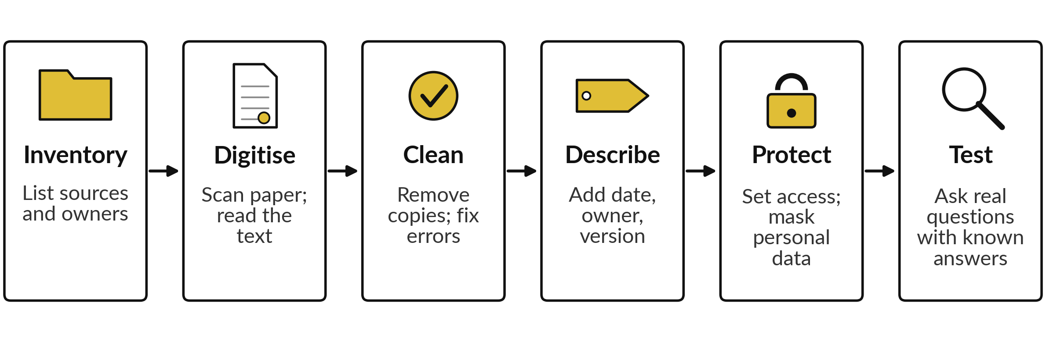
Six steps turn scattered files into AI-ready data
Start with one folder and one task. Test it, then widen.
Notes:
These are the six preparation steps from Session 0. Inventory first, because you cannot protect what you have not listed. Digitise: scan paper and read the text. Clean: remove duplicates and fix errors. Describe: add a date, an owner and a version. Protect: set who can see what and mask personal data.
Test: ask real questions with known answers and see what comes back. Today you do the first step and score the rest. In Session 12 the steps you still need become the lines of your roadmap. Start with one folder and one task.

Slide 12



Worked example: the Nile Valley Foods data
files can be read, and the faults are inside
File | Format | Can a model read it? | What is missing or wrong
weekly_sales.csv | CSV, 360 rows, 3 Aug to 19 Oct 2026 | Yes | No definitions: it does not say if revenue includes VAT
supplier_invoices.csv | CSV, 60 rows | Yes | 4 wrong totals, 2 missing PO numbers, 1 zero VAT, 1 duplicate
customer_messages.csv | CSV, 40 messages | Yes | 32 sender cells hold a phone number: personal data
Company Profile.pdf | One page, real text | Yes | No date and no owner
Fictional company. Counts recomputed from the practice files.
Notes:
Here is the first half of a worked example, using the real practice files of the fictional company Nile Valley Foods. The sales file has three hundred and sixty rows and is complete, but nothing says whether revenue includes VAT. The invoice file has sixty rows and eight faults: four wrong totals, two missing purchase order numbers, one invoice with zero VAT and one duplicate.
The customer messages file holds a phone number in thirty two of forty sender cells, so it is personal data. The company profile reads well but has no date and no owner.

Slide 13


Worked example: the documents
need rights and version checks
File | Format | Can a model read it? | What is missing or wrong
Busoga agreement | Word and a text copy | Yes | Confidential. Nothing says which copy is the signed one
staff_handbook_excerpt.txt | Text, version 4 | Yes | Has version, date and owner. Only an excerpt
cv_pack, 8 files | Text | Yes | Names, phones, emails: personal data
meeting_notes_raw.txt | Raw auto-transcript | Yes, but messy | Unedited; decisions sit inside speech
market_notes_1 to 4 | Text bulletins | Yes | Four publishers; prices differ between notes
The handbook shows what good metadata looks like.
Notes:
The second half. The supplier agreement exists as a Word file and a text copy, and nothing in either says which is the signed one. It is confidential. The staff handbook is the best example in the folder: it states version four, a date and an owner. The eight CVs hold names, phones and emails, so they carry the personal flag.
The meeting notes are a raw transcript, readable but messy, with decisions buried in speech. The four market notes come from four publishers and their prices differ, which you saw in Session 2.

Slide 14
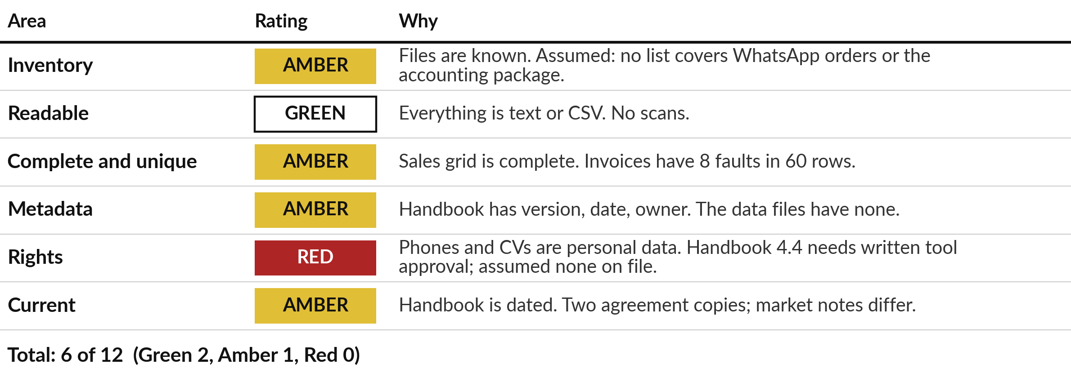
Worked example: the Nile Valley Foods
scorecard totals 6 of 12, with one red on rights
Assumed here: no written inventory and no tool approval exist. Yours come from your sources.
Notes:
Here are the six ratings for Nile Valley Foods, each with the evidence behind it. Inventory is amber: the files are known, but for this example I assume WhatsApp orders and the accounting package are on no list. Readable is green. Complete and unique is amber, because of the eight invoice faults.
Metadata is amber. Rights is red, because phones and CVs are personal data, and handbook clause 4.4 asks for the Managing Director to approve a tool in writing, and for this example I assume no approval is on file. Current is amber. The total is six of twelve. It is a conversation starter, and it is not a grade.

Slide 15

Worked example: three gaps,
each with evidence and a first fix
Gap | Evidence | First fix
1 Rights | Customer phones and CVs; no tool approval assumed | Managing Director names one approved tool; the lawyer checks the 2019 Act duties
2 Faulty invoices | 8 faults in 60 rows | Finance Manager fixes the file and keeps one current copy
3 No definitions | The CSV files carry no definitions or owner | Sales Manager writes a one-page data dictionary
Each fix has a name beside it. In Session 12 it gets a date, an effort and a measure.
Notes:
The worked example ends with three gaps, in order. First, rights, because it is the only red: the Managing Director names one approved tool and the lawyer checks the duties under the 2019 Act. Second, the faulty invoices: the Finance Manager fixes the file and keeps one current copy.
Third, no definitions: the Sales Manager writes a one page data dictionary. Notice that each gap has evidence, a first fix and a name. That is the shape of the page you write for your own company in a few minutes, and in Session 12 each line gets a date.

Slide 16



Decision: how wide will your assessment be?
Which sources will you assess today?
Your own task
One department
The whole company
Only the sources your Session 1 task uses. Recommended for today.
Every source one team holds. A fuller picture and more work.
Too wide for today. Keep it for a later round.
Say your choice aloud and write it at the top of the inventory.
Notes:
One decision before the break. How wide will your assessment be?
You can assess only the sources your own task uses from Session 1. You can take one department, every source one team holds. Or you can take the whole company, which is too much for today. My advice is your own task, because it keeps the work small and the evidence close.
You can repeat the method on a department later. Say your choice aloud, and your task and the first three sources you will list.

Slide 17
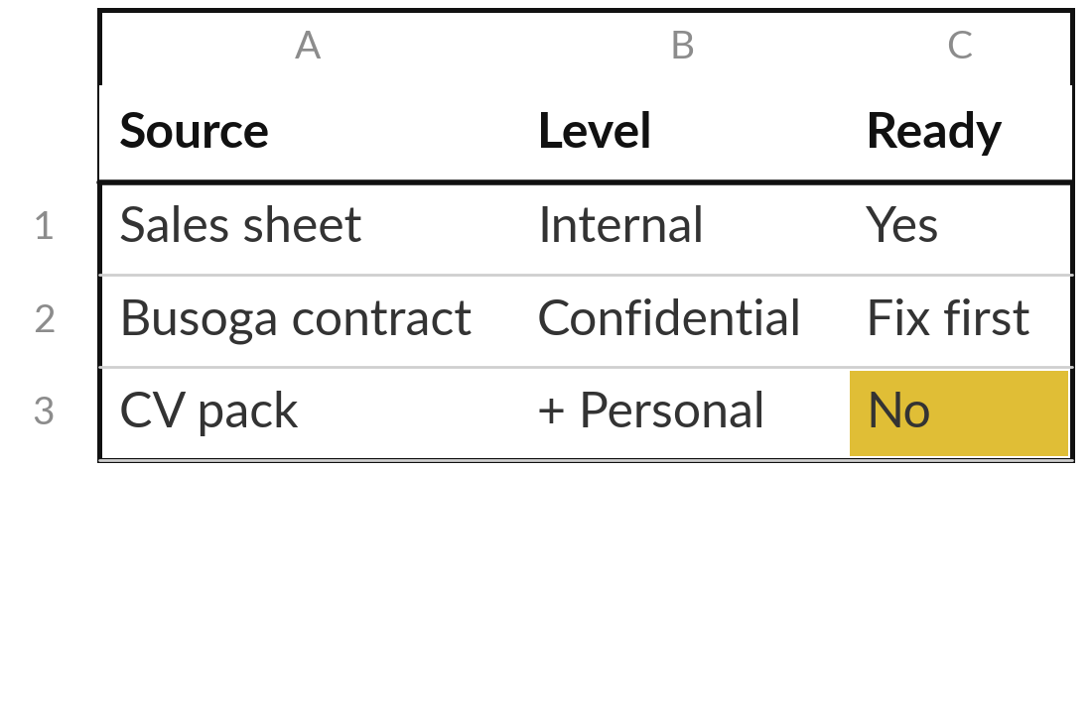
Practice: list your sources
and label each by sensitivity
20 minutes
Your own company task
Build your Information Inventory.
Open the Information Inventory template.
List every source your task uses, one per row.
Write owner, format, where it lives and who may see it.
Mark the level. Add + Personal when it names a living person.
Mark Ready for AI: Yes, Fix first or No.
You keep: An inventory of at least four sources, each labelled.
Notes:
Take twenty minutes. Open the Information Inventory and list every source your own task uses, one per row. Include the awkward ones: WhatsApp messages, paper files, a spreadsheet on one person’s laptop. For each, write the owner, the format, where it lives and who may see it. Then mark the level, and add the personal flag if it names a living person.
Last, say whether it is ready for AI: yes, fix first, or no. If you do not know the owner, write unknown. That is a finding. Aim for at least four sources. I will walk round.

Slide 18
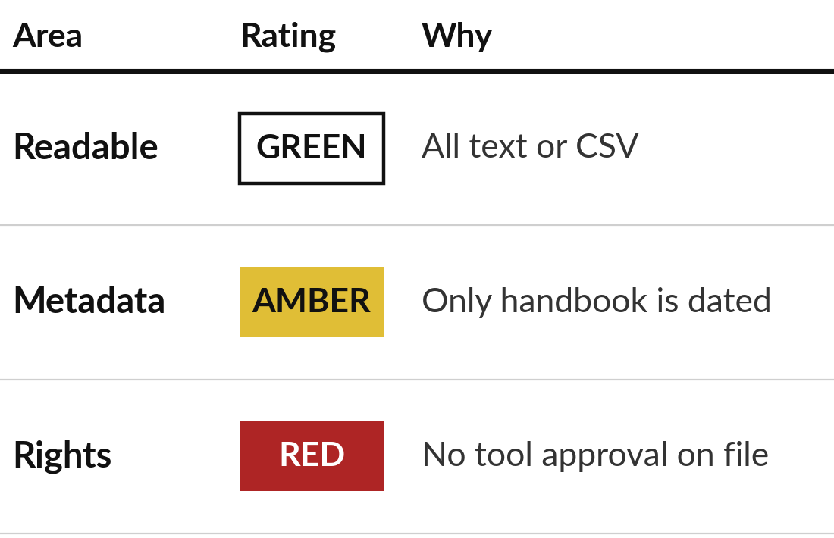
Practice: score the six areas for your own sources
20 minutes
Your own company task
Complete your readiness scorecard.
Look at your inventory rows for each area.
Rate it Green, Amber or Red using the rule table.
Write one line of evidence for each rating.
Add the points: Green 2, Amber 1, Red 0.
You keep: A scorecard: six ratings, six reasons and a total out of 12.
Notes:
Twenty minutes. Use your inventory to rate each of the six areas. For each one, find the rows that decide the rating, apply the rule from the table, and write one line of evidence. The evidence matters more than the colour, because it names the file or fact behind the rating.
Be strict on rights: if you do not know who may see a source, or whether it holds personal data, that is red until someone confirms. Then add the points. Green is two, amber one, red zero. Write the scorecard on the Readiness scorecard sheet of your Information Inventory.

Slide 19
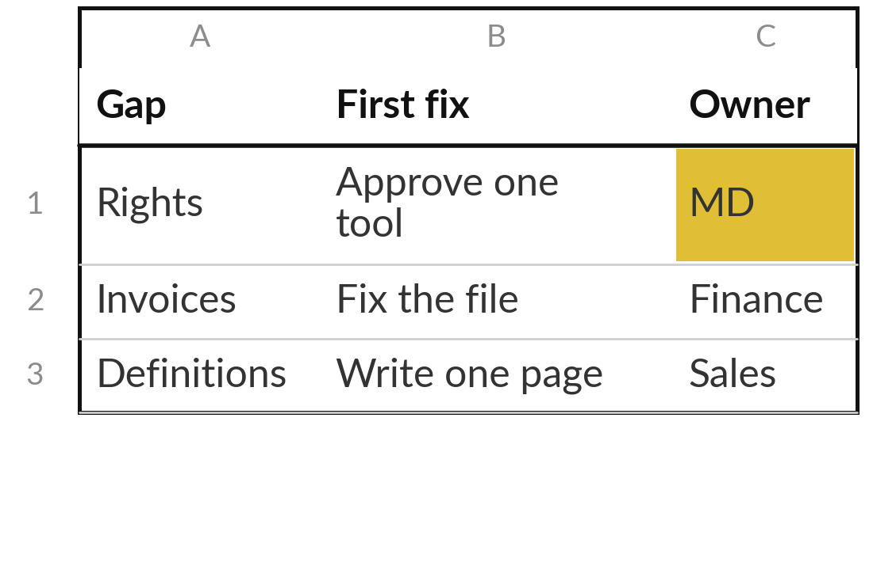
Practice: choose your top three
data gaps and a first fix for each
15 minutes
Your own company task
Write your top three data gaps.
Circle your Red and Amber areas.
Pick the three that block your task most.
Write the evidence and one first fix for each.
Name who could own each fix.
You keep: Three gaps, each with evidence, a first fix and a possible owner.
Notes:
Fifteen minutes. Look at your scorecard and circle the reds and ambers. Pick the three that block your task most. If you have only one red, start there and add the two ambers that cost you most. For each gap write the evidence, one first fix that a person could finish in days, and who could own it.
A fix such as improve data quality is too big. Fix the invoice file and keep one current copy is the right size. Say your top gap aloud when you finish, with the evidence for it.

Slide 20



Decision: which gap do you fix first?
Which of your three gaps starts your roadmap?
Rights and privacy
Quality and copies
Readable form
A red on rights stops everything. Start with your lawyer and one approved tool.
Faults and duplicates. Fix them before any assistant reads the file.
Paper and scans. Convert one folder first and check a sample.
Write your choice on the scorecard page. It starts your roadmap in Session 12.
Notes:
One decision to close. Which of your three gaps starts your roadmap?
If you have a red on rights, I would start there, because nothing else is safe to do until you know who may see what. If rights is clear, start with quality and copies, because an assistant cannot tell which of three files is the real one. If your files are on paper or in scans, convert one folder first and check a sample.
Say your choice aloud and write it on the scorecard page. In Session 12 it becomes the first line of your roadmap.

Slide 21
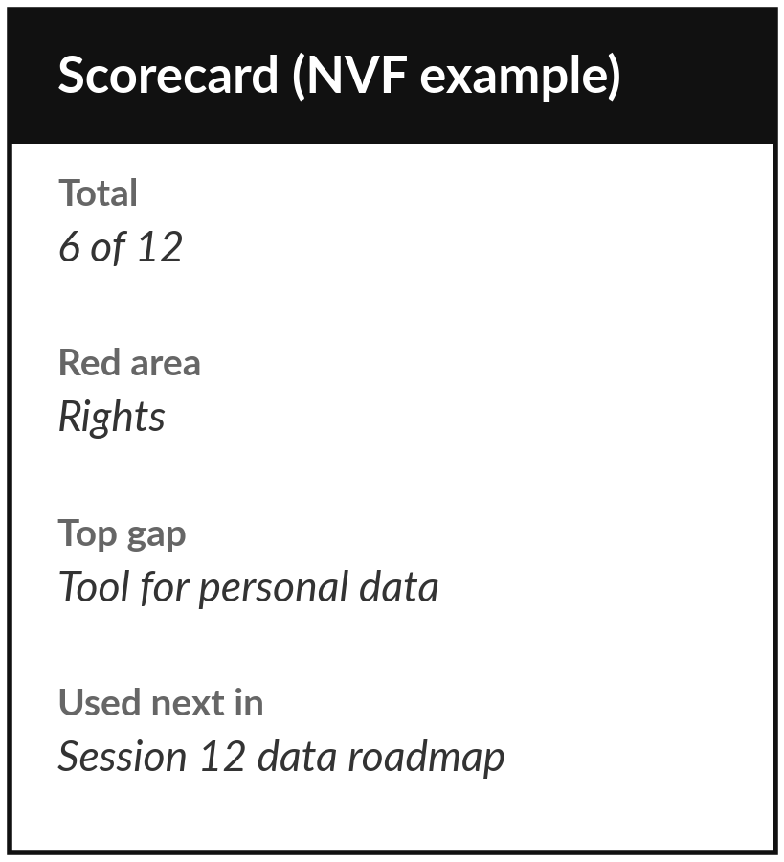
Save the three pages and
keep them for Session 12
What you keep from today
Your Information Inventory, your scored readiness scorecard and your top three data gaps. Session 12 turns them into a roadmap.
Our question today
Is my company’s data ready for AI, and what must I fix first?
Next session
Session 5: Reviewing documents with AI. You see AI review an agreement, CVs and meeting notes, against the key.
Notes:
Save three pages: the inventory, the scorecard and the top three gaps. We use them in Session 12, where they become a data roadmap with owners and dates. Optional before then: ask the owner of your biggest red or amber source one question, such as who may see it or which version is current, and write the answer on the inventory. That answer often changes a rating.
We began with this question: Is my company’s data ready for AI, and what must I fix first? Before you go, say in one sentence what you can now say about it.

